Slide 1
Introduction to Cryptography
Course Esilv 2025
arnaud.nauwynck@gmail.com

Slide 2
Communications
Point - to - Point
Broadcast
Destination Address
Dual Channel Communication ...example for Request - Response

Slide 3
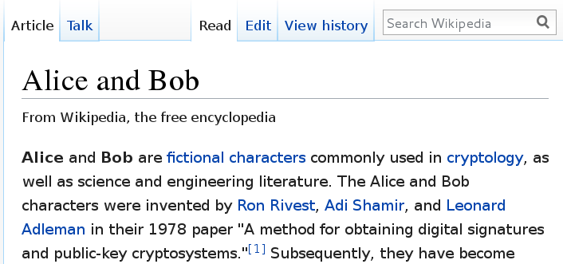
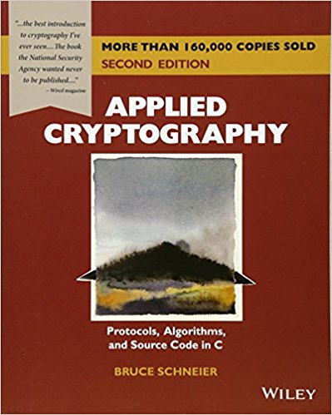
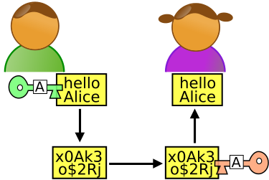
Who are Alice, Bob, Eve, Malory, & Trent .. ?

Slide 4
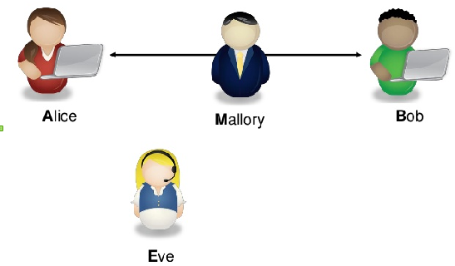
Eve (E=Environment … or Evil) and Malory (M=Malicious)
Mallory intercept + modify data … Eve does't not

Slide 5



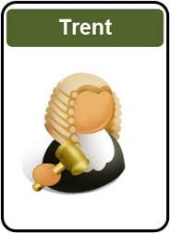
In Trent you (may) Trust

Slide 6

M = Malory = Malicious User Man-In-The-Middle

Slide 7
Man-In-The-Middle Weapons
Modification
Interruption
For Mallory only
Fabrication
Replay
For Eve
& Mallory
Passive
Interception

Slide 8
A (Secured?) Chat
Allo Bob ? Alice speaking
Hi Alice
I have a secret to tell you
I will tell you only if ...
Ok, I will do/pay/.. it
Secret = bla bla

Slide 9
What's (Possibly) Wrong ?
Be Paranoiac !!
By Default, Everything is wrong
Proofs next ...

Slide 10
Possibly Wrong
Authentication
Data Leak
Authentication
Confidentiality
Data Replay
Integrity
Predicatable guess
Authorisation
...
Password Crack

Slide 11
Authentication Server (or substitued server?)
Allo Bob ? Alice speaking
Hi Alice
(imitating Bob's voice)
victim of DNS Spoofing

Slide 12
Client Authentication
Allo Bob ? Alice speaking
(imitating Alice's voice)
Hi Alice
I have been stolen
my password

Slide 13
… Social Engineering
Allo Bob ? I am a friend of Alice
She asked me to tell you..
Hi
Sure, go ahead
Bob is so naive

Slide 14
Authentication denied
Allo Bob ? Alice speaking
Your voice is strange I don't recognize Alice's voice
Bye

Slide 15
Basic Authentication
Allo Bob ? Alice speaking proof I am Alice: my password is ..
Hi Alice
(imitating Bob's voice)
Your password is OK
Allo Bob ? Alice speaking proof I am Alice: my password is ..
Hi Alice
Your password is OK

Slide 16
Password Challenge
Allo Bob ? Alice speaking
Really ? Proove me your identity
I don't give my password I can give you only a clue you can check with Trent
OK, Send me you pass hashed by “X”
( .. Compute Y=hash(P,X) )
It is “Y”
Is it True that ? “Y” ?= Alice pass hashed by “X”
OK Alice

Slide 17
Trusted Thirdparty...
Allo Bob ? Alice speaking
Really ? Proove me your identity
Please Attest I am Alice (here is my password)
I (“Trent”) certify this token paper was delivered to Alice on jun 2017:
XADS4FSQ3RTXF
Bob: Ask “Trent” … he prooved my identity by token XADS4FSQ3RTXF
Is it true this token was given to Alice: XADS4FSQ3RTXF ?
OK Alice
Yes (And Alice did not complain yet being stolen)

Slide 18
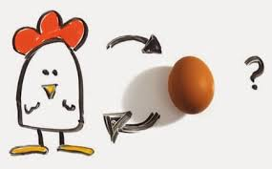
Problems With Thirdparties...
Hi ! Are you Trent ?
Are You Alice?

Slide 19
Physical Hand-Shake ... Exchange Shared Key
Bob, here is a secret “key” for talking to you in 6 monthes
Hi Bob Let us use our private shared key (remember I gave you last 6 monthes) ..
** Switch Encrypted ** SDFG23456RGQEST43

Slide 20
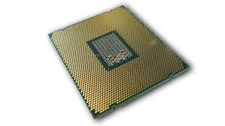
“Key” recomputed from Data ...
Encrypt using “Key”
Decrypt using “Key”
SFWXV 34TSQS
“Hi ...”
***
blabla
***
“Regards”
“Hi ...”
Test all possible “Key”
Knowing that message “SFWXV..”
matches “Hi*”

Slide 21
“Key” inversion from Predicatable Data
WARN : do NOT use TOO many data too easily predicatable data
otherwise “Key” could be recomputed by Eve...
Throw “Key” at end of communication
Famous during World War 2 : Alan Turing decrypted German Submarine “Enigma” Messages … partly because all messages ended with “Hi Hitler”

Slide 22
Encrypted … & Still Weak
Authentication
Data Leak
Authentication
Confidentiality
Data Replay
Integrity
Predicatable guess
Authorisation
...
Password Crack

Slide 23
(Partial) Data Leak Example : Modulo - Hashes
Challenge response (1)
My password modulo 1000 is 4
Challenge response (2)
My password modulo 6421 is 2
Challenge response (3)
My password modulo 9482 is 7

Slide 24
Partial Data Leak Padding – Delay...
Try password1..
Wrong password (answer after 10ms)
Try password2..
Wrong password (answer after 11ms)
Try password9..
Wrong password (answer after 20ms)
Seems to finish by “9” … it tooks more time to compute all

Slide 25
Encrypted … Data Replay
Encrypted credit card number: “XDFGZFG”
Encrypted credit card number: “XDFGZFG”

Slide 26


Using Shared Key for Exchanging TMP SessionKey ONLY
Hi Bob Let us use our private shared key (remember I gave you last 6 monthes) .. ONLY TO EXCHANGE A NEW Random Key!
** Switch encrypted (shared key) ** ( sessionKey=) SDFG23456RGQEST43
Generate new Random Key
** Switch encrypted (new session key) ** ( secret =) G2HA0QEG3HHF5SSG.....
Delete temporary session key

Slide 27
Fast Crypt using for example XOR + Session Key Random Generator (modern app would use AES-256)
** Switch encrypted (shared key) ** ( seed =) G2HA0QEG3HHF5SSG.....
Generate new Seed Random Generator
( encrypt seed =) G2HA0QEG3
(seed) ….
(seed) ….
….. → 1 0 1 0
….. → 1 0 1 0
** Switch encrypted (XOR seed generator mode) ** ...
Secret message blabla ….
Seed gen
Seed gen
..
0 1 0 1 1 1 0 1 1 ..
..
0 1 0 1 1 1 0 1 1 ..
1 0 1 0 0 1 0 1 0
1 0 1 0 0 1 0 1 0
Secret message blabla ….

Slide 28


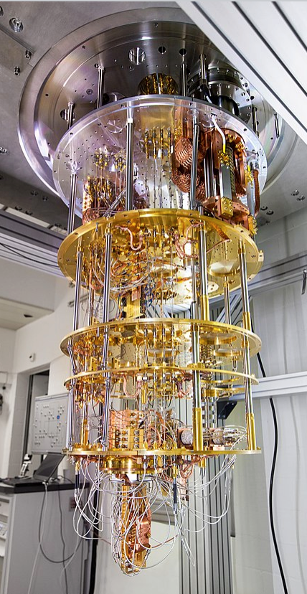

Forward Secrecy Property ?
Eve record the full conversation
... BUT (as of 2024) is NOT able to decrypt (yet)
Years LATER ....
..Use Quantum
Computer

Slide 29
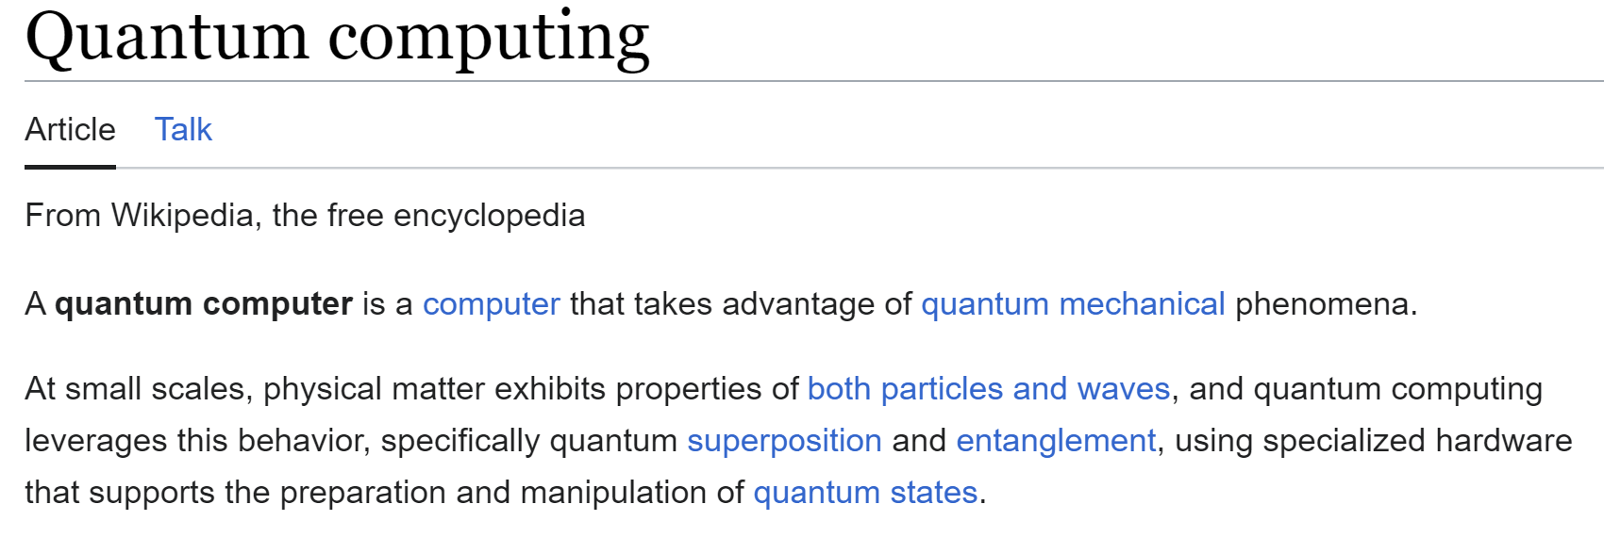
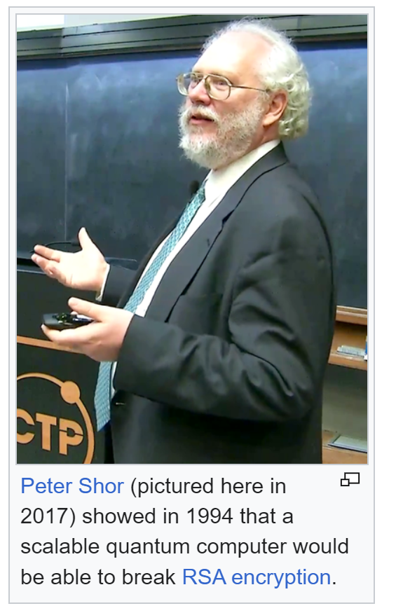
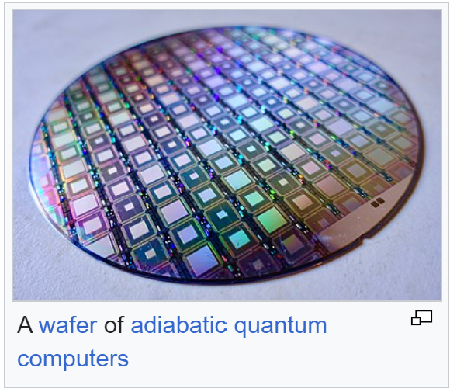

Slide 30
Family of Cryptographic Functions
Problem Solving
Proof Of Work
One-Way (Irreversible) Hashing
2-Way (Reversible)
Permutation
XOR
Hide/Extract (Steganography)
Key Encrypt-Decrypt
Symmetric Key
Shared
Assymmetric Key Public-Private
Randomization
Entropy Generator
Pseudo Random Generator

Slide 31
Family of Cryptographic Functions
Problem Solving
Proof Of Work
One-Way (Irreversible) Hashing
2-Way (Reversible)
Permutation
XOR
Hide/Extract (Steganography)
Key Encrypt-Decrypt
Symmetric Key
Shared
Assymmetric Key Public-Private
Randomization
Entropy Generator
Pseudo Random Generator

Slide 32
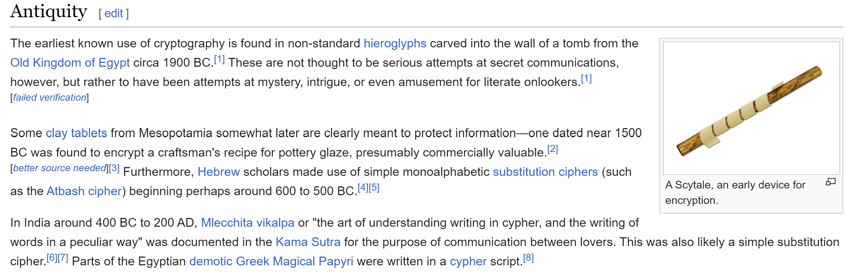
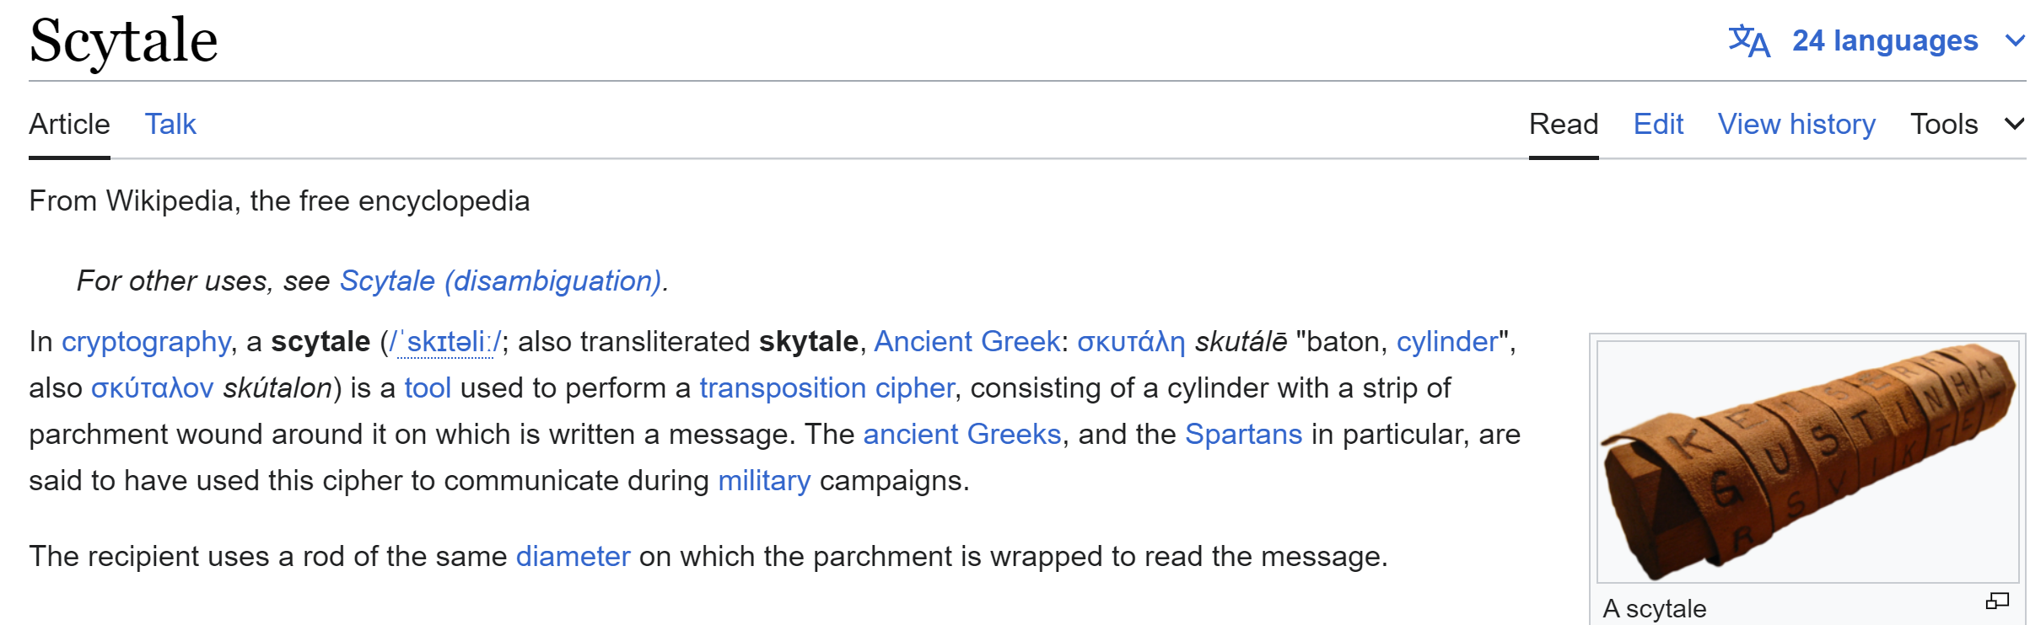
History Cypher

Slide 33
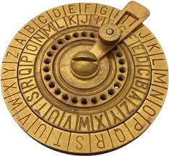
Julius Caesar Cypher

Slide 34
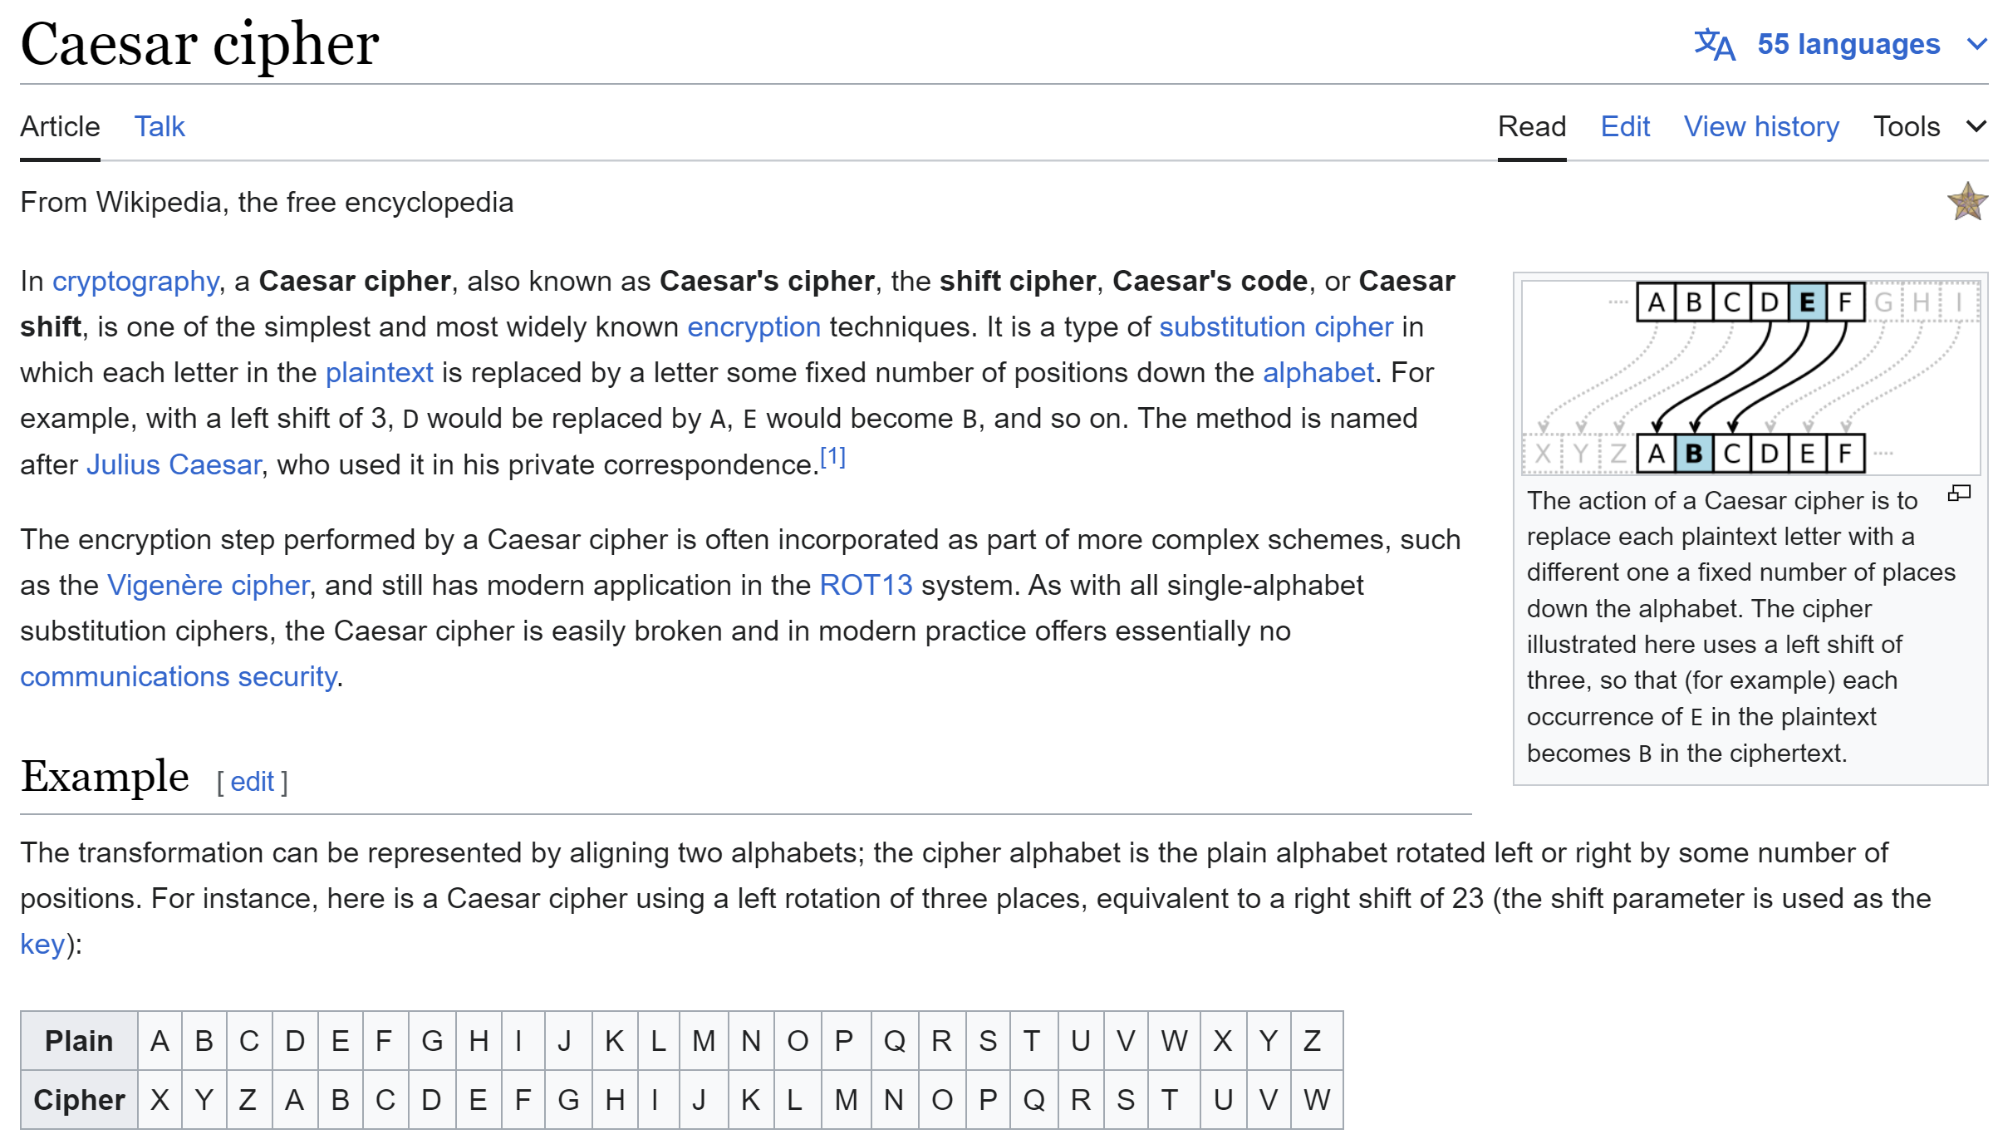

Slide 35
Caesar Java Code
public static String caesarShift(String data, int shift) { int len = data.length(); StringBuilder res = new StringBuilder(len); for(int i = 0; i < len; i++) { char ch = data.charAt(i); if (ch == ' ') { res.append(' '); continue; } int chIndex = ch - 'a'; int newIndex = (chIndex+shift) % 26; char newChar = (char) ('a' + newIndex); res.append(newChar); } return res.toString(); }

Slide 36
Caesar Cypher... why it is so weak ?
cfdbvtf pg gsfrvfodz bobmztjt gps dpnnpo mfuufs mjlf f

Slide 37
Frequency Analysis
int[] freq = new int[26]; for(int i =0, len = cypherStr.length(); i < len; i++) { char ch = cypherStr.charAt(i); if (ch == ' ') { continue; } int chIndex = ch - 'a'; if (0 <= chIndex && chIndex < 26) { freq[chIndex]++; } } for(int i = 0; i < 26; i++) { System.out.print(i + ":" + freq[i] + " "); }
most occurence found = 8
0:0 1:3 2:1 3:3 4:0 5:8 6:3 7:0 8:0 9:2 10:0 11:1 12:3 13:2
14:3 15:4 16:0 17:1 18:3 19:3 20:2 21:2 22:0 23:0 24:0 25:2
this letter is probably "e"
it is the 6th position (index 5 starting at 0)
while "e" is the 5th letter of alphabet
suspecting shift by "1"

Slide 38
Too Few Possibilities (Brute Force),
Leaking information (space not encrypted)
Frequency Analysis, ...
dgecwug qh htgswgpea cpcnauku hqt eqooqp ngvvgt nkmg g
ehfdxvh ri iuhtxhqfb dqdobvlv iru frpprq ohwwhu olnh h
figeywi sj jviuyirgc erepcwmw jsv gsqqsr pixxiv pmoi i
gjhfzxj tk kwjvzjshd fsfqdxnx ktw htrrts qjyyjw qnpj j
hkigayk ul lxkwaktie gtgreyoy lux iussut rkzzkx roqk k
iljhbzl vm mylxblujf huhsfzpz mvy jvttvu slaaly sprl l
jmkicam wn nzmycmvkg ivitgaqa nwz kwuuwv tmbbmz tqsm m
knljdbn xo oanzdnwlh jwjuhbrb oxa lxvvxw unccna urtn n
lomkeco yp pboaeoxmi kxkvicsc pyb mywwyx voddob vsuo o
mpnlfdp zq qcpbfpynj lylwjdtd qzc nzxxzy wpeepc wtvp p
nqomgeq ar rdqcgqzok mzmxkeue rad oayyaz xqffqd xuwq q
orpnhfr bs serdhrapl nanylfvf sbe pbzzba yrggre yvxr r
psqoigs ct tfseisbqm obozmgwg tcf qcaacb zshhsf zwys s
qtrpjht du ugtfjtcrn pcpanhxh udg rdbbdc atiitg axzt t
rusqkiu ev vhugkudso qdqboiyi veh secced bujjuh byau u
svtrljv fw wivhlvetp rercpjzj wfi tfddfe cvkkvi czbv v
twusmkw gx xjwimwfuq sfsdqkak xgj ugeegf dwllwj dacw w
uxvtnlx hy ykxjnxgvr tgterlbl yhk vhffhg exmmxk ebdx x
vywuomy iz zlykoyhws uhufsmcm zil wiggih fynnyl fcey y
wzxvpnz ja amzlpzixt vivgtndn ajm xjhhji gzoozm gdfz z
xaywqoa kb bnamqajyu wjwhuoeo bkn ykiikj happan hega a
ybzxrpb lc cobnrbkzv xkxivpfp clo zljjlk ibqqbo ifhb b
zcaysqc md dpcosclaw ylyjwqgq dmp amkkml jcrrcp jgic c
adbztrd ne eqdptdmbx zmzkxrhr enq bnllnm kdssdq khjd d
because of frequency analysis for common letter like e
for (int shift = 1; shift < 26; shift++) { System.out.println(caesarShift(cypherStr, shift)); }

Slide 39
Signal Theory ...
Information / Entropy / Randomness
This signal has many redundant information
(constrained by grammar, known dictionary words, logic..)
encrypt
plain text
?x@4*Qwa.8
This signal should appear completly random
with no repeatition, no "information"

Slide 40


Compress Then Encrypt
... not
Encrypt Then Compress
encrypt
plain text
plain text
gzipXa1kj
?x@4*Qwa.8
encrypt
plain text
plain text
?x@4*Qwa.8
gzipAsdfg.hijs3dnf7gsXa1kj

Slide 41
XOR ...
VERY VERY Fast
(might) works with “Good” Pseudo Random Generators
Secret message blabla ….
Xor MASK
XOR MASK
0 1 0 1 1 1 0 1 1 ..
0 1 0 1 1 1 0 1 1 ..
1 0 1 0 0 1 0 1 0
1 0 1 0 0 1 0 1 0
Secret message blabla ….

Slide 42
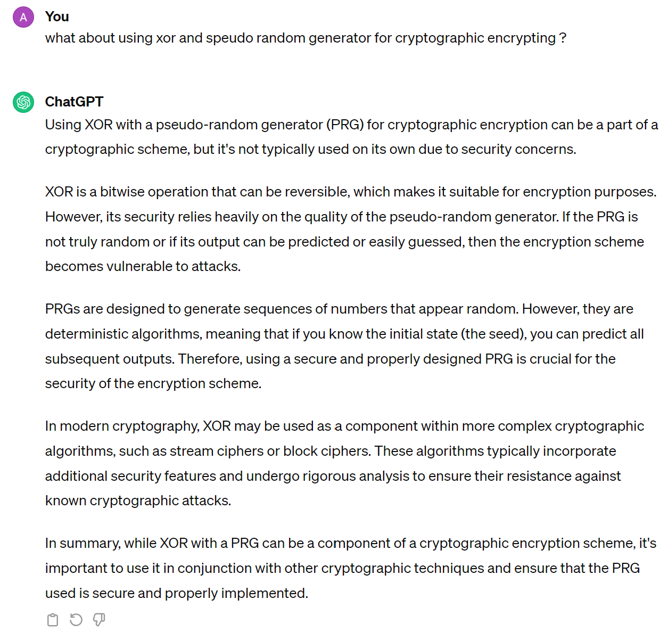

Slide 43
Problem
writing BIG predictable fragments of 000000...000
=> output leaks internal information of the state (=Key)

Slide 44
Permutations
P: [1..N] → [1..N]
P is a permutation if it is inversible (all elts are reached once)
b1 b2 b3 … bN
P
bp(1) bp(2) bp(3) … bp(N)
-1
P
b1 b2 b3 … bN

Slide 45
Family of Cryptographic Functions
Problem Solving
Proof Of Work
One-Way (Irreversible) Hashing
2-Way (Reversible)
Permutation
XOR
Hide/Extract (Steganography)
Key Encrypt-Decrypt
Symmetric Key
Shared
Assymmetric Key Public-Private
Randomization
Entropy Generator
Pseudo Random Generator

Slide 46
Combining Several Permutations (and XOR & Non-Linear & ...)
b1 b2 b3 … bN
Step 1
XOR Mask1
m1 m2 m3 … mN
b1 b2 b3 … bN
Step 2
Permut
P2
1Round
Step 3 : Add Key
b1 b2 b3 … bN
b1 b2 b3 … bN
Key1 Key2 … keyK
Step 4 : XOR Mask4
m1 m2 m3 … mP
b1 b2 b3 … bN bN+1 … bP
Step 5
Permut
P
Repeat N Rounds...

Slide 47

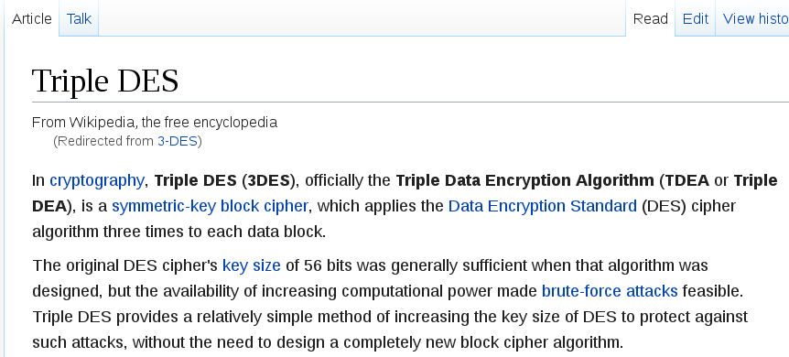
Example : 3-DES Wikipedia article as of 2017

Slide 48
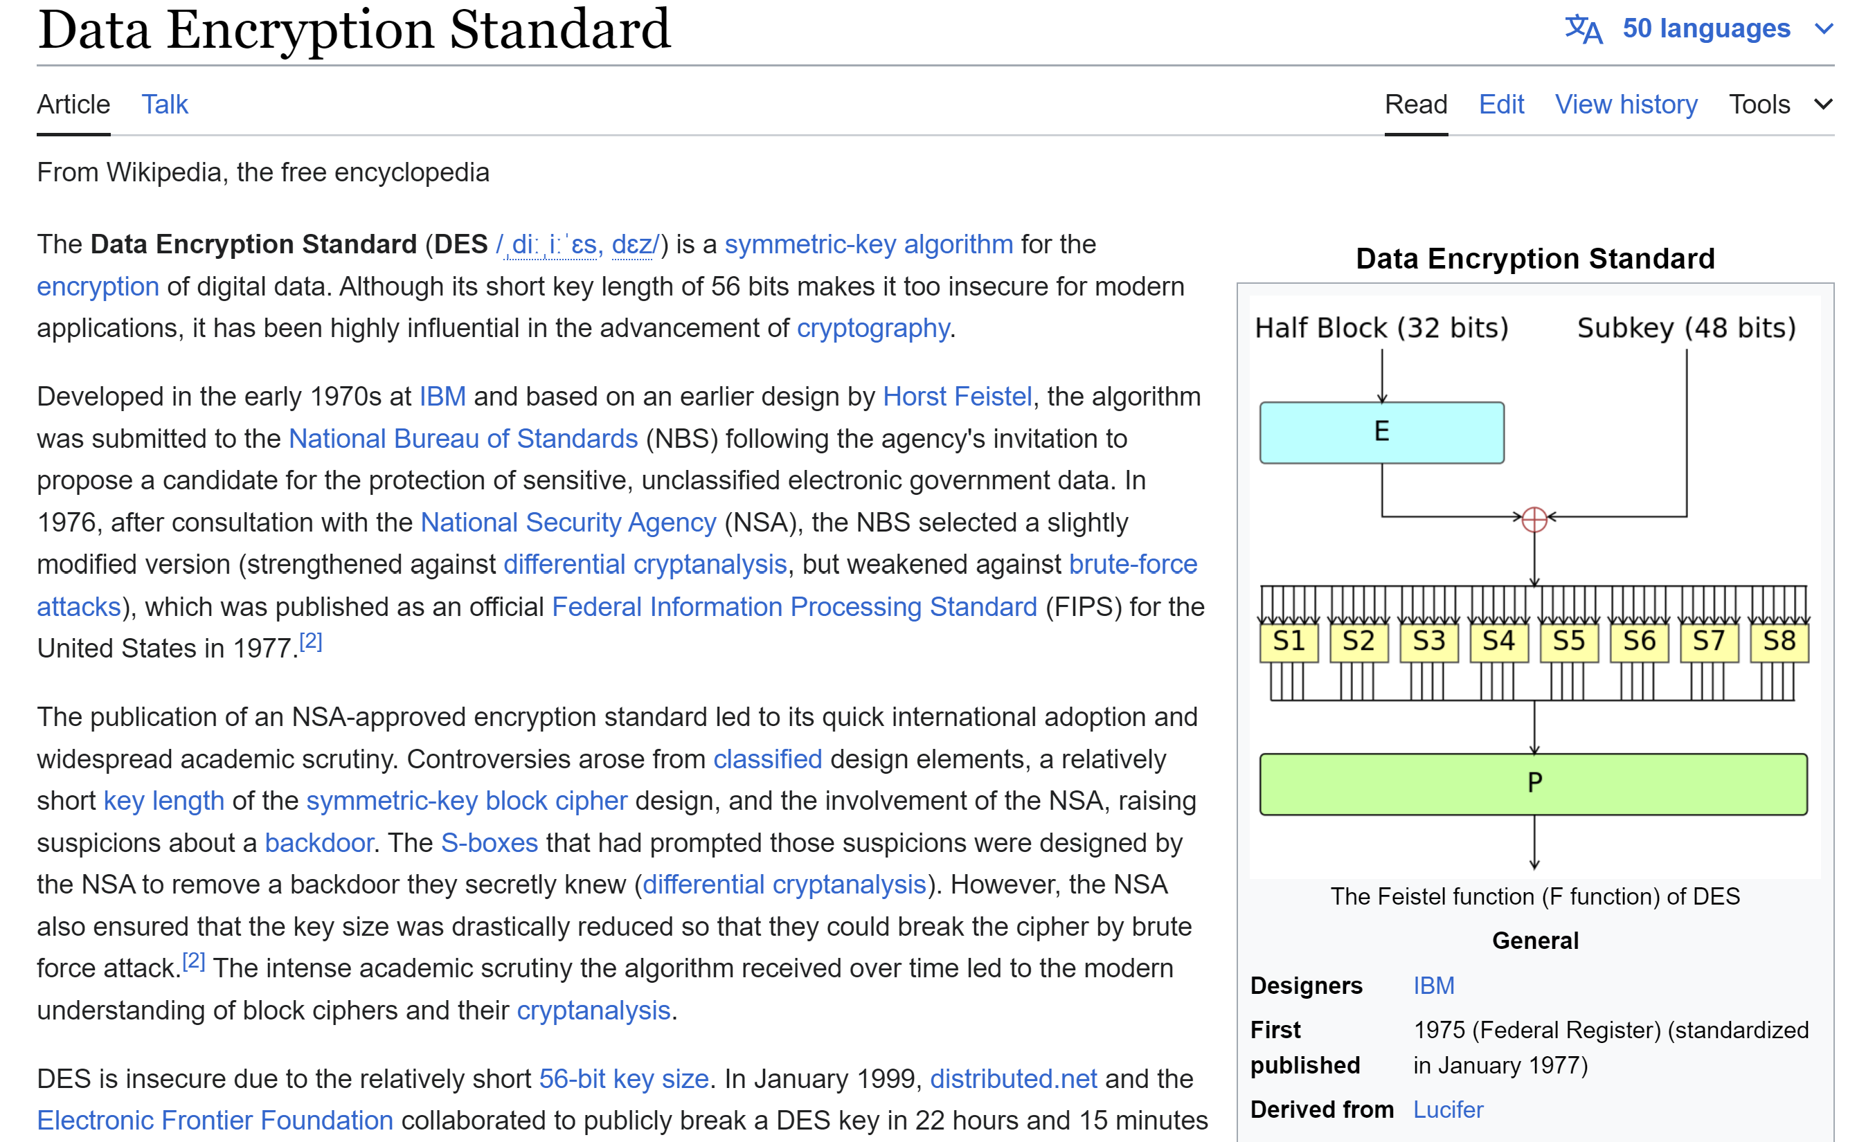
3-DES Wikipedia page updated 2024

Slide 49
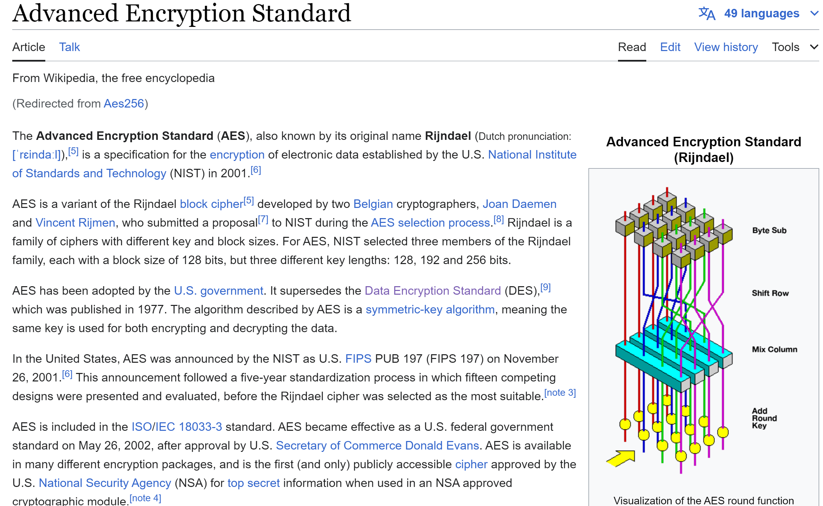
as of 2024 ... AES-256
= established standard

Slide 50
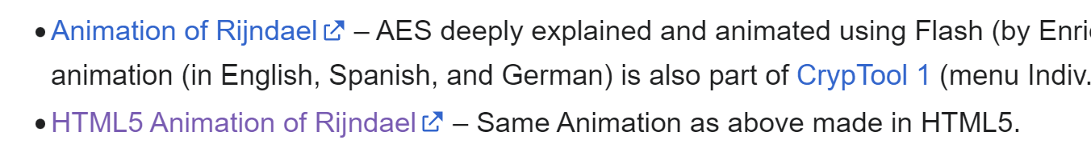
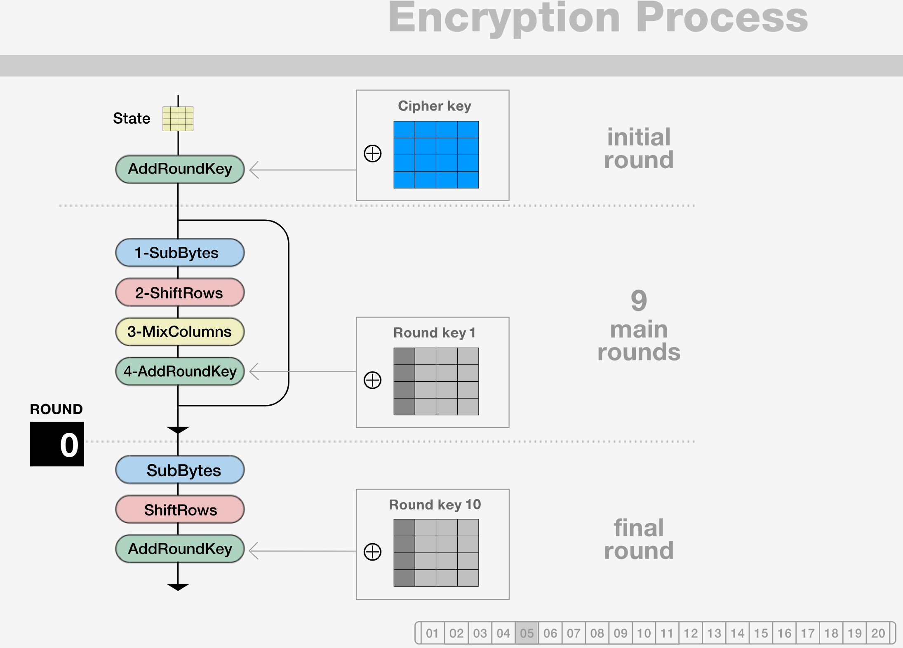
AES - Animation Video
https://formaestudio.com/rijndaelinspector/archivos/Rijndael_Animation_v4_eng-html5.html

Slide 51
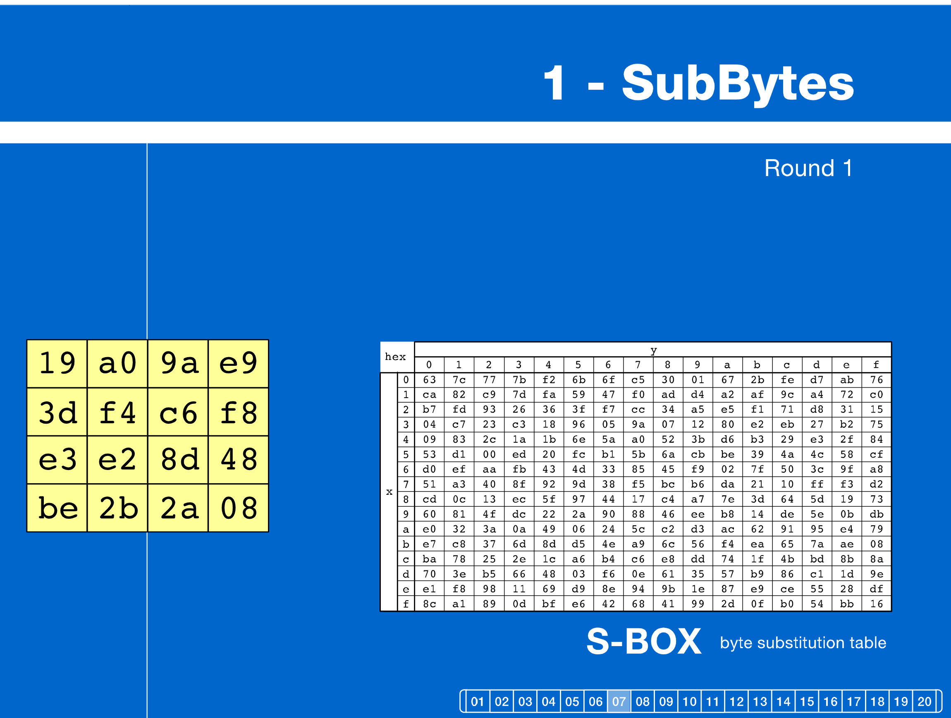
AES : S-BOX [step 7/20]

Slide 52
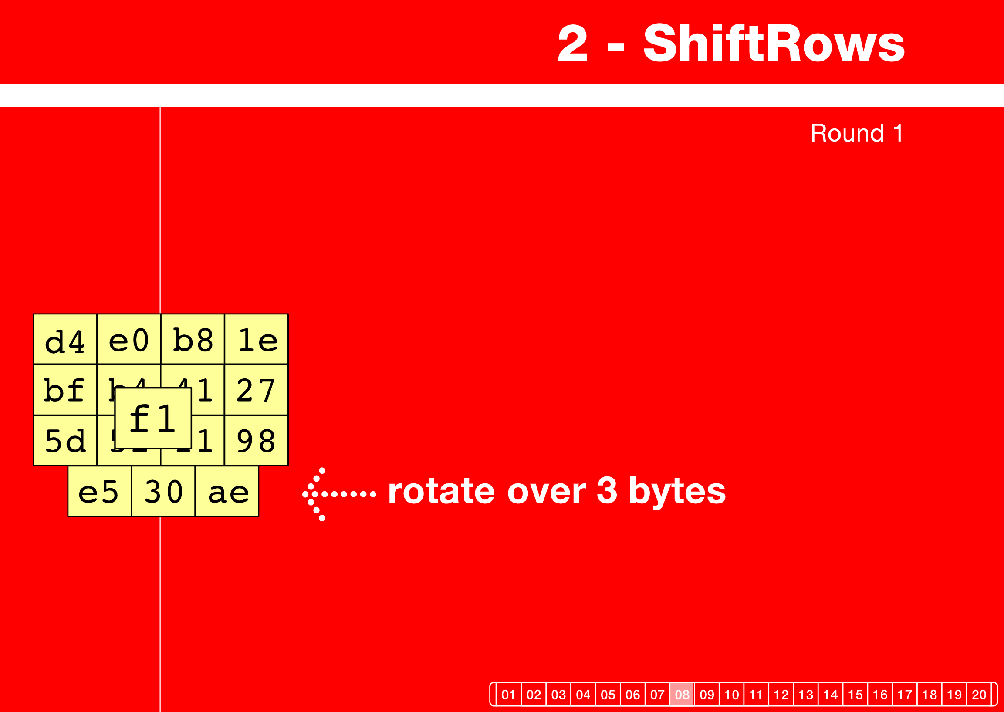
AES : Rotate ShiftRows [step 8/20]

Slide 53
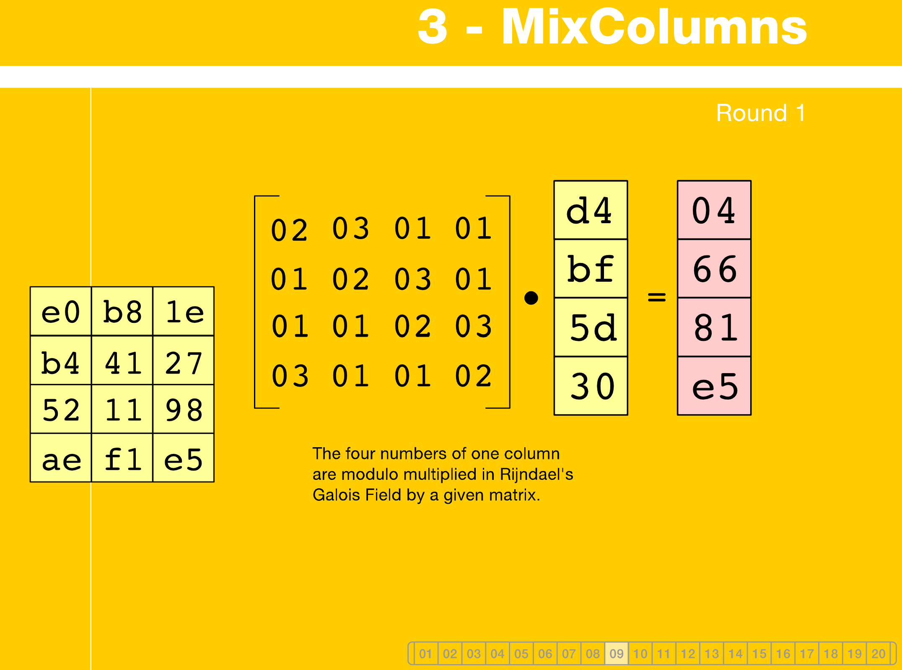
AES : MixColumn [step 9/20]

Slide 54
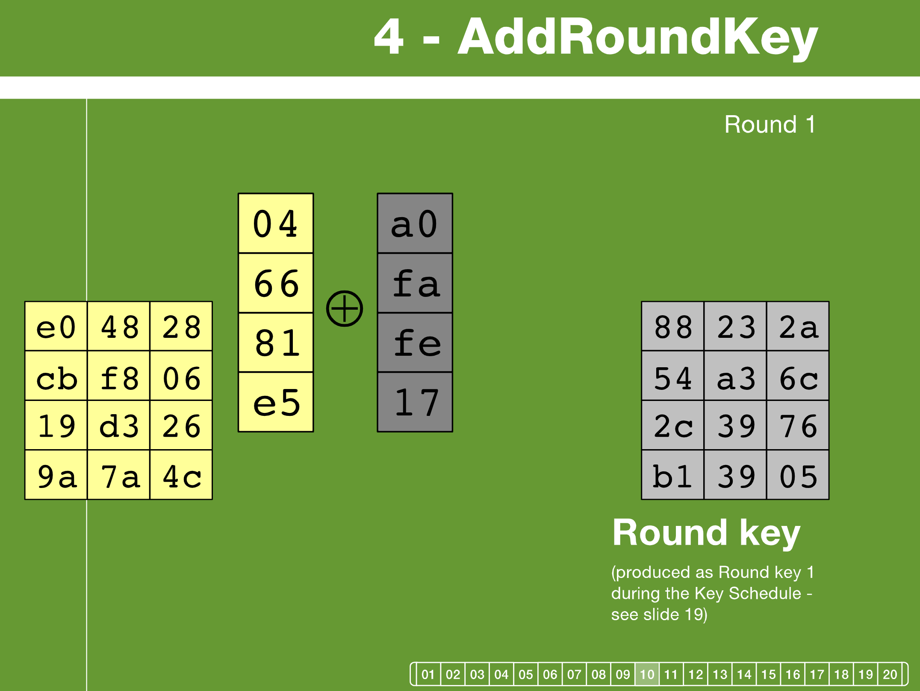
AES : XOR AddRoundKey [step 10/20]

Slide 55
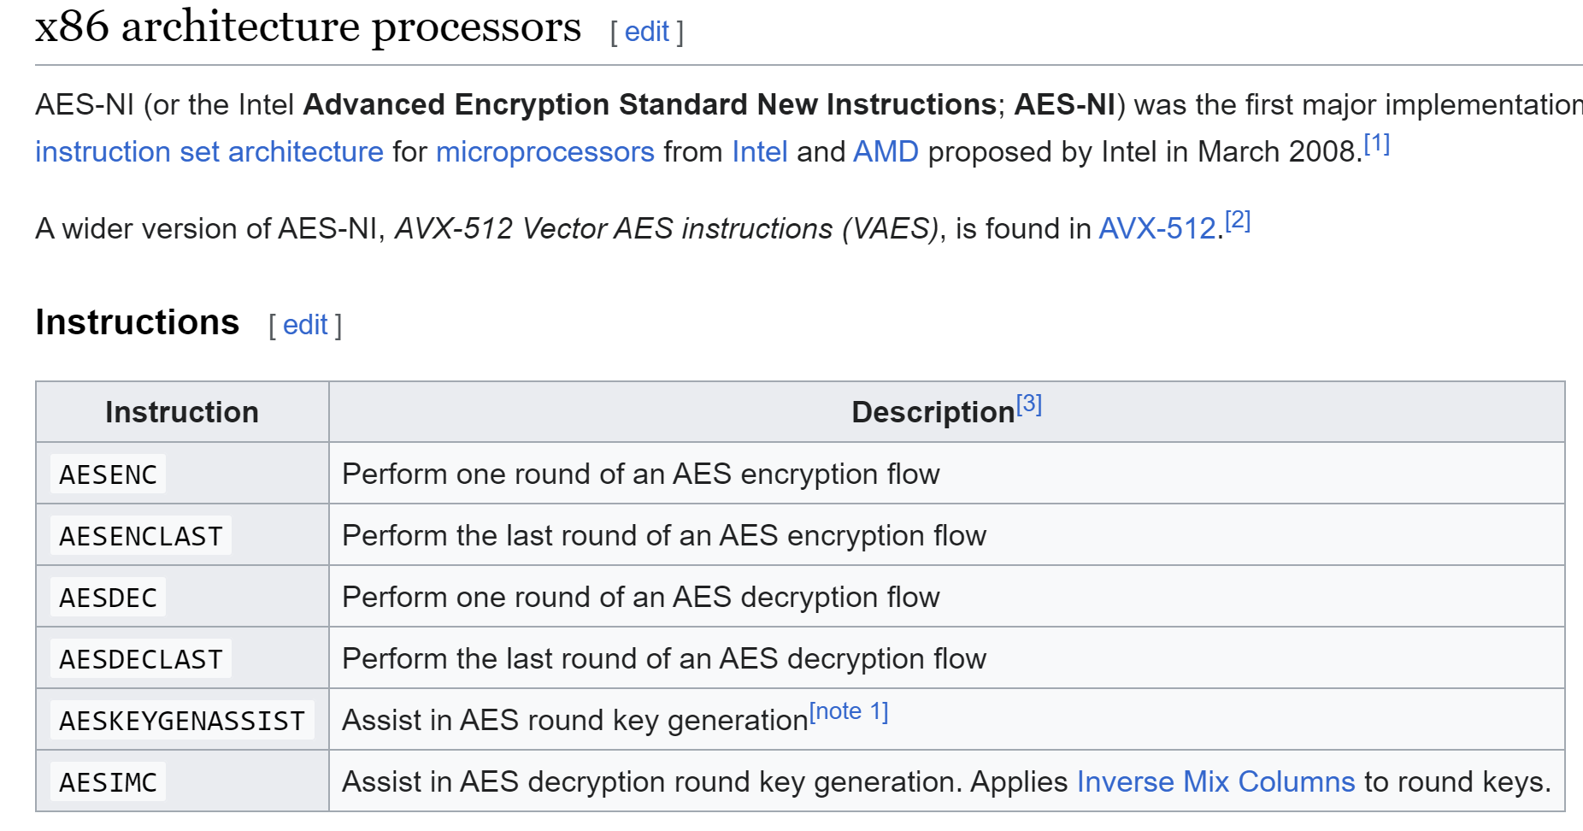
AES optimized instructions
in Intel,Amd processors

Slide 56
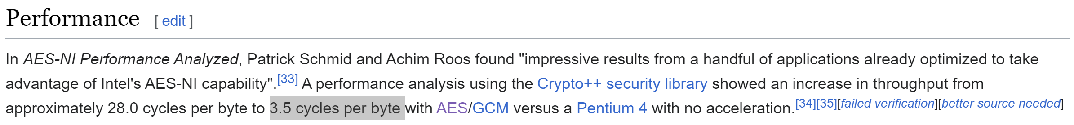
AES performances
Software => 28 cycles per byte
Hardware => 3.5 cycles per byte (x9 faster)

Slide 57
Family of Cryptographic Functions
Problem Solving
Proof Of Work
One-Way (Irreversible) Hashing
2-Way (Reversible)
Permutation
XOR
Hide/Extract (Steganography)
Key Encrypt-Decrypt
Symmetric Key
Shared
Assymmetric Key Public-Private
Randomization
Entropy Generator
Pseudo Random Generator

Slide 58
Assymetric Keys
Private
Public
Only “Priv” can encode
Everybody can decode (= check Signature)
Private
Public
msg
encrypted
msg
Every body can encode
Only “Priv”
can decode
Public
Private
msg
encrypted
msg

Slide 59
Public Keys – Private Keys...
Public
msg
transformed
Private
Keys define 2 operations : inverse of each others
Like +X → -X *X → /X
^N →sqrt^N

Slide 60
But Deducing Keys MUST Be Impossible/Difficult
Public
msg
transformed
Deducing Private Key From Public Key
MUST Be Impossible
Private

Slide 61
Combining 2 Pairs of Pub-Priv Keys
PrivA
PrivB
PubA
PubB
Exchange Public Keys
PubA
PubB
Inverse
Inverse
PrivA
PubB
msg
intermediate
encrypted
PrivB
PubA
encrypted
intermediate
msg
Every body can encode
Only “Priv” can decode

Slide 62
Assymetric Keys For Secured 2-Way Channel
Only Alice can encode
Only Bob can decode
Secure channel Alice to Bob
PrivA
PubB
msg
intermediate
Encrypted msg
Only Alice can decode
Only Bob can encode
Secure channel Bob to Alice
PubA
PrivB
Encrypted resp
Int. resp
resp

Slide 63
Man In The Middle...
PrivE1
PrivE2
PrivA
PrivB
PubA
PubE1
PubE2
PubB
PubE1
PubE2
Interception of Pub Key Exchange … Alice<-> Bob
Alice trust “PubE1”
Bob trust “PubE2”
Instead of PubB
Instead of PubA
PrivE1
PubA
Re-encode as-of “Bob”
PubE2
PrivB
Decode as-of “Alice”

Slide 64
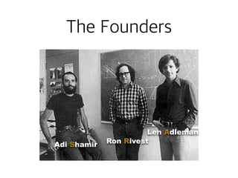
RSA : Rivest Shamir Adleman

Slide 65
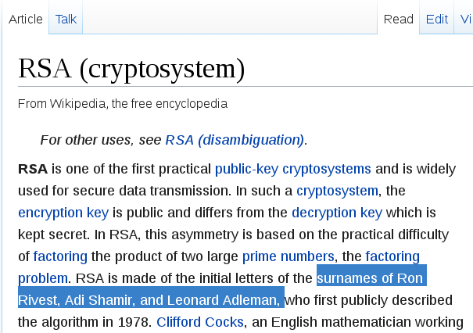
RSA :first practical, widely used

Slide 66
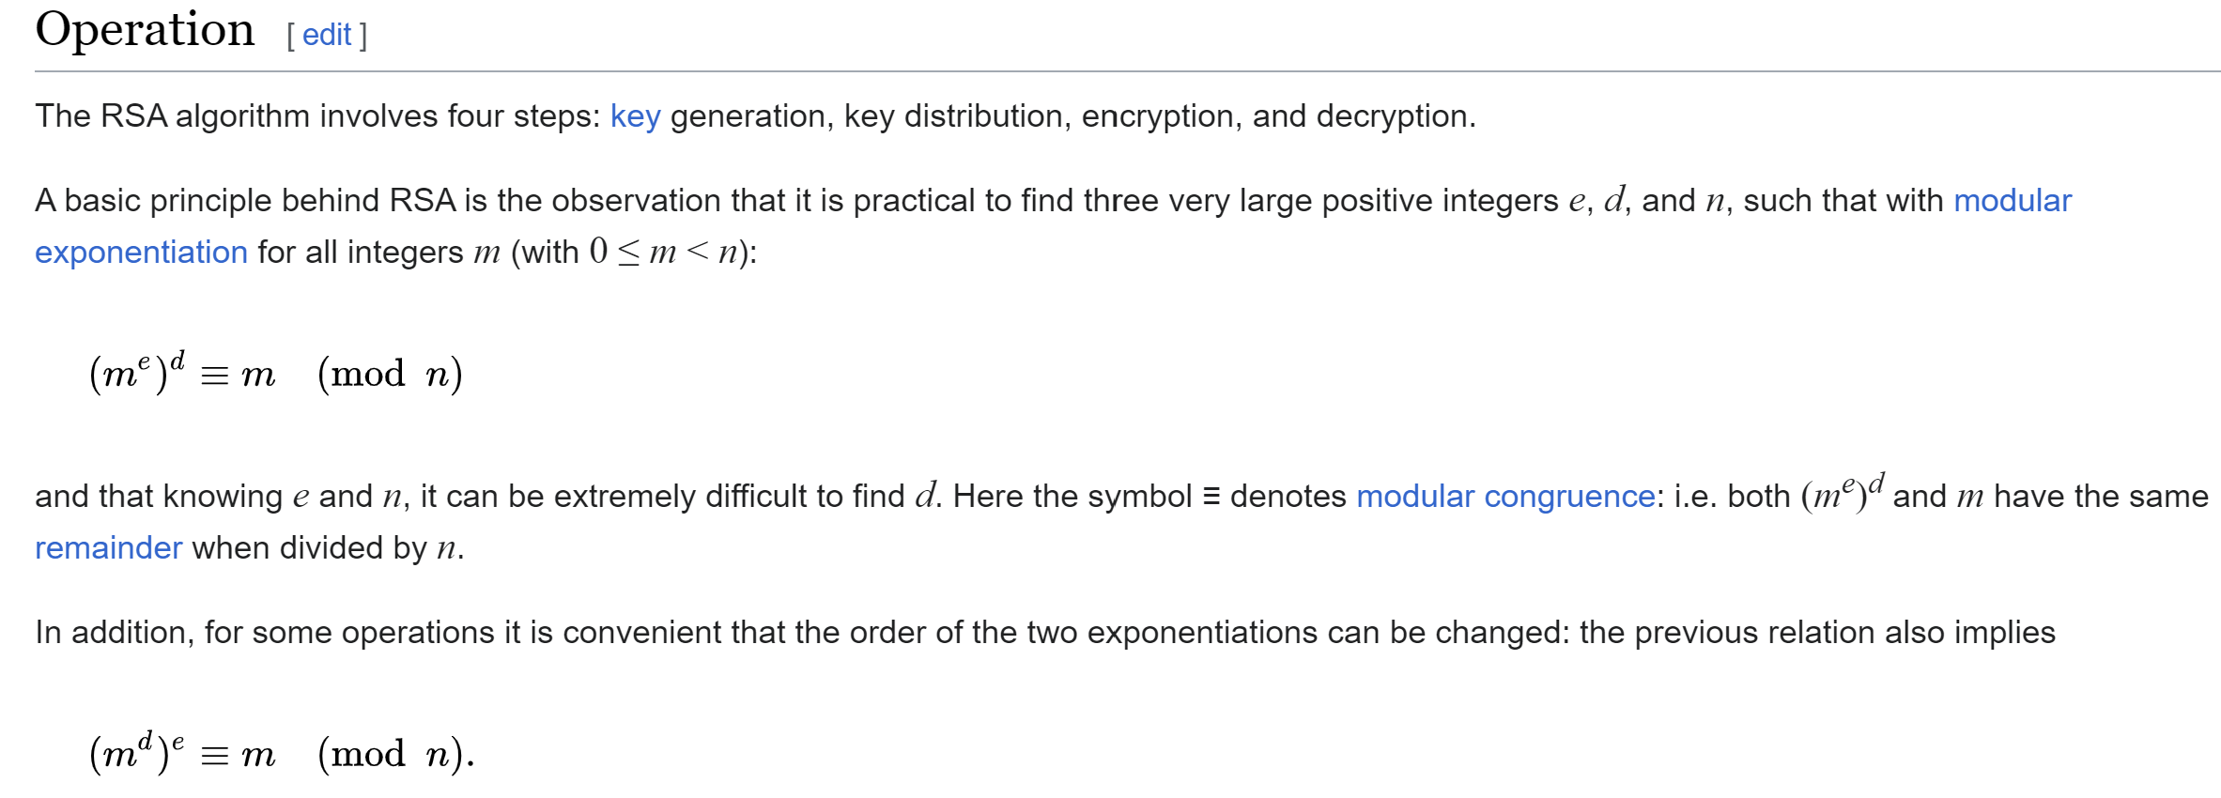

Slide 67
Basic Math: Modulo definition
Remember Euclidian Division
Let N a number > 0
Every number divided by N has a quotient and a remainder – also called modulo
x / n : for all x => there exist(uniq) q & r with 0<=r<n x = q n + r
Modulo N function: x → x mod[n] = r

Slide 68
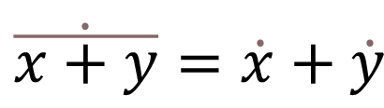
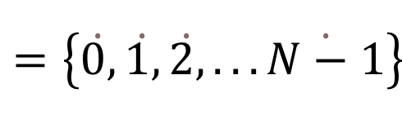
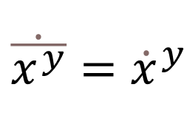
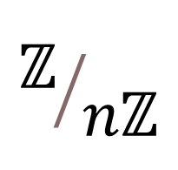
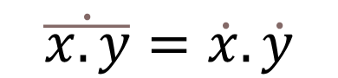
Algebra Operation on Modulos
(x + y ) mod [n] = ( x mod [n] + y mod [n] ) mod[n]
(x * y ) mod [n] = ( x mod [n] * y mod [n] ) mod[n]
Reasonning on equivalence classes, for equivalence relation “R”: a R b <=> a-b mod[n]=0
$$ℤ/{nℤ}$$
$$=\left\{\dot{0,}\dot{1,}\dot{2,}...\dot{N−1}\right\}$$
$$\dot{\overline{x+y}}=\dot{x}+\dot{y}$$
$$\dot{\overline{x.y}}=\dot{x}.\dot{y}$$
$$\dot{\overline{x^{y}}}={\dot{x}}^{y}$$

Slide 69
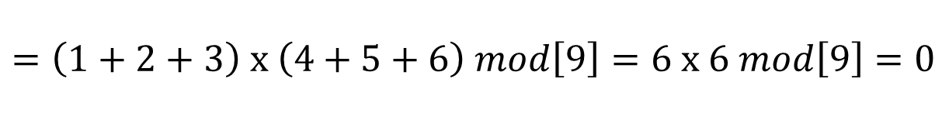
Example on modulo 9
Doing modulo 9 as a 9-year old boy at school … sum digits to check operations
$$123 x 456 mod\left[9\right]=56088 mod\left[9\right]=\left(5+6+0+8+8\right) mod\left[9\right]=0$$
$$=\left(1+2+3\right) x \left(4+5+6\right) mod\left[9\right]=6 x 6 mod\left[9\right]=0$$
This works because 10 mod[9]=1 .. 100 mod[9]=1, 1000 mod[9]=1 so whatever X written in decimal format:
$$\left(a_{n}{10}^{n}+a_{n−1}{10}^{n−1}+..a_{2}{10}^{2}+a_{1}10+a_{0}\right) mod\left[9\right]=\left(a_{n}+..+a_{1}+a_{0}\right) mod\left[9\right]$$

Slide 70
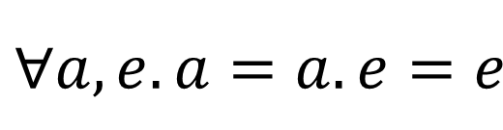
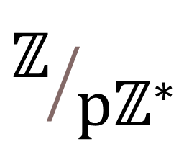
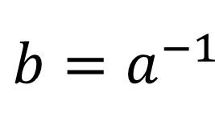
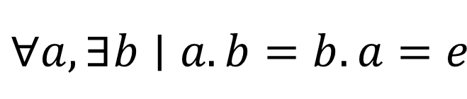
When p is prime, is a multiplicative Group
$$ℤ/{pℤ^{∗}}$$
Remember Group definition ?
G = { g0, g1, ...gN } a Set of elements with an operation “.” (inside G)
Is a “group over .”
If it exists a neutral element “e”
every element has an inverse:
$$∀a,e.a=a.e=e$$
$$∀a,∃b∣a.b=b.a=e$$
$$b=a^{−1}$$
( b is unique and is the inverse of a : )

Slide 71
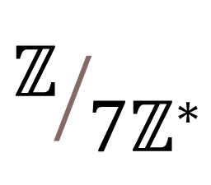
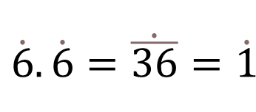
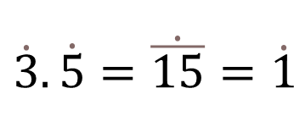
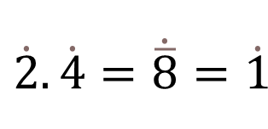
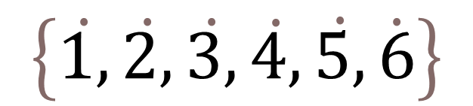
Example
$$ℤ/{7ℤ^{∗}}$$
$$\left\{\dot{1,}\dot{2,}\dot{3,}\dot{4,}\dot{5,}\dot{6}\right\}$$
Neutral element
Inverse of each others
Self Inverse
$$\dot{2}.\dot{4}=\dot{\overline{8}}=\dot{1}$$
$$\dot{3}.\dot{5}=\dot{\overline{15}}=\dot{1}$$
$$\dot{6}.\dot{6}=\dot{\overline{36}}=\dot{1}$$

Slide 72
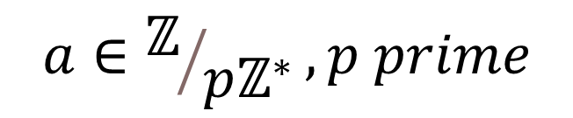
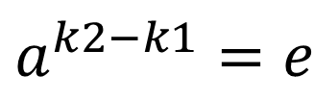
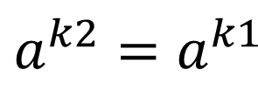
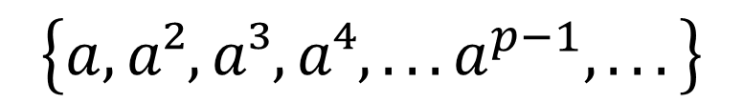
Consecutive Powers … (=Orbits)
$$a∈ℤ/{pℤ^{∗}},p prime$$
$$\left\{a,a²,a³,a⁴,...a^{p−1},...\right\}$$
Is inside finite set..
so is cyclic ...
let k2 index be the first repetition of already seen k1 elt:
$$a^{k2}=a^{k1}$$
Taking inverse
$$a^{k2−k1}=e$$
then proof next that k2-k1=p-1

Slide 73
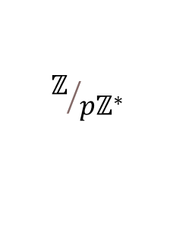



Orbits are all similar... all equals
whatever a, the orbit contains e... so orbits contains
$$\left\{a,a^{2,}..a^{p−2},e\right\}$$
For 2 elements a & b … orbits of a and b are identical, “scaled”
By a factor
$${ a}^{−1}b$$
b
$$a^{−1}b$$
So For any orbit, card Orbit = cst
If they are N orbits, they all cover the set
$$ℤ/{pℤ^{∗}}$$
a
If p is a prime number … (sub-orbit N can not divide P prime)
… There is only 1 orbit, containing ALL elements !

Slide 74








Example
$$ℤ/{7ℤ^{∗}}$$
Start for example with a = 3
Compute a, a² ...
$$a=\dot{3}$$
$$a²=\dot{3}\dot{3}=\dot{\overline{9}}=\dot{2}$$
$$\left\{\dot{1,}\dot{2,}\dot{3,}\dot{4,}\dot{5,}\dot{6}\right\}$$
$$a^{3}=\dot{\overline{3.2}}=\dot{6}$$
$$a^{4}=\dot{\overline{3.6}}=\dot{4}$$
$$a^{5}=\dot{\overline{3.4}}=\dot{5}$$
$$a^{6}=\dot{\overline{3.5}}=\dot{1}$$

Slide 75



“Small Theorem” of Fermat
$$∀a∈ℤ/{pℤ^{∗}},p prime$$
$$a^{p−1}=1 mod\left[p\right]$$
$$a^{p}=a mod\left[p\right]$$

Slide 76



Relationship with Crypto? ... choose 2 primes
k < n n= k + (n-k)
a |-->
$$a^{ k }=b$$
$$b ⇒ b^{n−k}=a$$
encrypt
decrypt
$${= \left(a^{k}\right)}^{n−k}=a^{k+\left(n−k\right)}=a mod p$$

Slide 77


Making Cryptography out of 2 primes ?
$$a^{p1}=a mod\left[p1\right]$$
For p1,p2 2 prime numbers...
$$a^{p2}=a mod\left[p2\right]$$
$$a^{p1.p2}={\left(a^{p1}\right)}^{p2}=a mod\left[p1p2\right]$$
Intuitively … Try decompose p1.p2 as a different product of 2 key parts “e.d mod[..]” … but not as p1.p2 (too easy) !

Slide 78


RSA ...
Technically.. solve e and d...
$$e.d=1mod\left[ϕ\left(p1p2\right)\right]$$
Then
$${\left(a^{e}\right)}^{d}=amod\left[p1p2\right]$$
And also
$${\left(a^{d}\right)}^{e}=amod\left[p1p2\right]$$

Slide 79
Inverting Key .. need Decomposing N in p1.p2
Choose 2 HUGE primes p1,p2
Multiply N=p1.p2
… give N to someone and reward 1M$ IF he finds back p1 & p2

Slide 80
Naive Search...
Given N
Try decompose :
for ( BigInteger i = N; ; i = i-2 ) { if (divides(i, N)) { p1 = i; break; } }

Slide 81
How HUGE is HUGE enough?
1024
Example: choose p1 > 2
=2.2.2. …. (1024 times) ~ 1000 . 1000 …. (1014 times)
~ 1 000 000 000 … (3000 zeros)
In Theory : Decomposition Program finishes
In Practise :
- More than Atoms in Universe
- Slow... 1CPU => 1000...00000 centuries
- Energy : 1000...000 CPUS => requires more power than 1000...000 solars

Slide 82
Possible to Find so HUGE Primes?
In Theory : infinite numbers of Primes
Storing all primes from [0, 2^1024] ?? ... is even harder than counting them
Primes become rare : Count primes in [0, N] ~ log N
There always exist a prime in [k, 2k]

Slide 83
Find One Random (!) Huge Prime Efficiently (?)
Given start = random number > 2^N-1 … with N~1024
for ( BigInteger i = start; ; i = i+2 ) { if (isPrime(i)) { p = i; break; } }

Slide 84




Need Efficient Primality Test
$$pisprime⇔$$
$$∀a∈ℤ/{pℤ^{∗}}$$
$$a^{p−1}=1mod\left[p\right]$$
$$a^{p−1}\left[p\right]$$
Choose any a, for example a=27
Compute
If != 1
p is NOT prime
If == 1
Probability 1/p that p is anyway not prime
Reapeat for b=43
Confirm .. or proba 1/p^2

Slide 85




Efficient Compute Powers..
Write in basis-2 (binary representation)
$$p−1=b_{0}2^{0}+b_{1}2^{1}+..b_{n}2^{n}$$
$$∀i,b_{i}∈\left\{0,1\right\}$$
Then
$$a^{p−1}=a^{b_{0}}.a^{2b_{1}}....a^{2^{n}b_{n}}$$
$$=\left\{\begin{matrix}a^{1}ifb_{1}=1 \\ 1ifb_{1}=0\end{matrix}\right\}.\left\{\begin{matrix}a^{2}ifb_{2}=1 \\ 1ifb_{2}=0\end{matrix}\right\}....\left\{\begin{matrix}a^{2n}ifb_{n}=1 \\ 1ifb_{n}=0\end{matrix}\right\}$$
square
square

Slide 86


Efficient (Enough?) Powers Compute
1024
P ~ 2
N=log2(p)=1024
$$a^{p−1}$$
Computable in o(2.N multiplications)
BUT Would be a HUGE number …
$$a^{p−1}\left[p\right]$$
Computable in o(2.N multiplications + 1.N modulo)
… quite FAST, with small memory need

Slide 87


Not Efficient Enough For Video & High Traffic Network !!!
But OK for small DATA
~ 1ms on a CPU
Embeddable in RDA SecurID card ship
OK For Exchanging a symmetric Key … then using AES-256 cypher
Application : TLS protocol (previous SSL), for example in

Slide 88



SmartCard ... Not only "memory", but also RSA "Compute"
(auto-block after 3 PIN attempts)

Slide 89

Securing Hardware
... not only Network/Software !

Slide 90

RSA = "big" Compute Resource
... maybe not suitable
=> Alternatives .. ECC

Slide 91
Family of Cryptographic Functions
Problem Solving
Proof Of Work
One-Way (Irreversible) Hashing
2-Way (Reversible)
Permutation
XOR
Hide/Extract (Steganography)
Key Encrypt-Decrypt
Symmetric Key
Shared
Assymmetric Key Public-Private
Randomization
Entropy Generator
Pseudo Random Generator

Slide 92



Fast Pseudo-Random Generators
Back to Math : Doing Polynomials
$$P\left[X\right]=a_{0}+a_{1}X+a_{2}X²+..a_{n}X^{n}$$
… Polynomials over Z/2Z modulos, truncated to Rank N
$$⇒P\left[X\right]∈Z/{2Z}$$
$$X∈Z/{2Z}=\left\{\dot{0,}\dot{1}\right\}$$
$$∀i,a_{i}X∈Z/{2Z}$$
… we are interrested not in X … put in P (in coefficients) algebra of P : P1, P2, … P1.P2, P1+P2

Slide 93



Consecutive Powers of P
Consecutive (truncated) powers of P :
$$\left\{P\left[X\right],P^{2}\left[X\right],P^{3}\left[X\right]...P^{2^{N}}\left[X\right]...\right\}$$
If “P” is chosen irreductible in Z/2Z[n] … then orbit contains all polynoms!
(all coefficients of all polynoms)
$$card\left(\left\{a_{1}a_{2}...a_{n}\right\}\right)=2^{2^{n}}$$
$$2^{2^{64}}≃2^{{10}^{9}}$$
Suppose N = 64 … then
.. a Pseudo-Random generator HUGE cycle

Slide 94

Multiply (and Truncate) Polynoms
$$A\left[X\right]=a_{0}+a_{1}X+a_{2}X²+..a_{n}X^{n}$$
$$B\left[X\right]=b_{0}+b_{1}X+b_{2}X²+..b_{n}X^{n}$$
$$A.B\left[X\right]=A\left[X\right].B\left[X\right]=a_{0}.b_{0}+\left(a_{0}b_{1}+a_{1}b_{0}\right)X$$
$$+\left(a_{0}b_{2}+a_{1}b_{1}+a_{2}b_{0}\right)X²+..\left(a_{0}b_{n}+..a_{n}b_{0}\right)X^{n}$$
$$+truncated..X^{n+1}..X^{2n}$$

Slide 95



Efficient for P=1+X using Bit Shift, Bit And..
$$A\left[X\right]=a_{0}+a_{1}X+a_{2}X²+..a_{n}X^{n}$$
$$B\left[X\right]=1+X$$
$$A.B\left[X\right]=a_{0}+\left(a_{0}+a_{1}\right)X+\left(a_{1}+a_{2}\right)X²+...$$
$$a_{1}a_{2}a_{3}...a_{n−1}a_{n}$$
$$a_{2}a_{3}a_{4}...a_{n}0$$
Bit Shift
+
$$\left(a_{1}+a_{2}\right)\left(a_{2}+a_{3}\right)..\left(a_{n−1}+a_{n}\right)a_{n}$$

Slide 96
Family of Cryptographic Functions
Problem Solving
Proof Of Work
One-Way (Irreversible) Hashing
2-Way (Reversible)
Permutation
XOR
Hide/Extract (Steganography)
Key Encrypt-Decrypt
Symmetric Key
Shared
Assymmetric Key Public-Private
Randomization
Entropy Generator
Pseudo Random Generator

Slide 97

Hashing ...
Hashing is One-Way transformation
Hashing different product usually give different result
!=
!=

Slide 98
Hashing … must be equi-distributed minimise “Collisions”
A Hashing Collision
!=
==
Of course if can happen … example in java: “public int hashCode()” by default Object.hashCode = System.identityHashCode(x)
= … 64bits pointer (when first hashed) → hashed to 32 bits = ( hashPtr64 ^ (hashPtr64 >>>32))

Slide 99


Hashing : MD5, SHA-1, SHA-256, SHA-512 ..

Slide 100
Hashing For Storing “Passwords”
Create Login Account
Hash
A password
Extra SALT
pass Hash
Check Password
Hash Again
Same HASH ?
(assume pass OK)
A password
Extra SALT
pass Hash

Slide 101
Hashing : Good for Signing
Hash to (example) 512 bits
A message to sign ….
Msg Hash
Private
A message to sign ….
encrypted(msg Hash)
Signed Message : clear text + extra signature (at bottom of page)
Check that a message signature is VALID :
Public
1: recompute Hash
2: decrypt signature
Msg Hash
Msg Hash
3: check equals

Slide 102



Certificates = Signed Public Keys
Certificate Public Key Certificate Signature ...

Slide 103
Family of Cryptographic Functions
Problem Solving
Proof Of Work
One-Way (Irreversible) Hashing
2-Way (Reversible)
Permutation
XOR
Hide/Extract (Steganography)
Key Encrypt-Decrypt
Symmetric Key
Shared
Assymmetric Key Public-Private
Randomization
Entropy Generator
Pseudo Random Generator

Slide 104

Hash a BitCoin Transactions Chain BlockChain

Slide 105

Merkle Tree

Slide 106

Proof Of Work, Mining

Slide 107

Other BlockChains (for contracts, legal ownership, assurance, ..)

Slide 108

Conclusion

